Slide 1
2021
B11901027 王仁軒
PPT TemplateCredit : Jie-Hong Roland Jiang

Slide 2
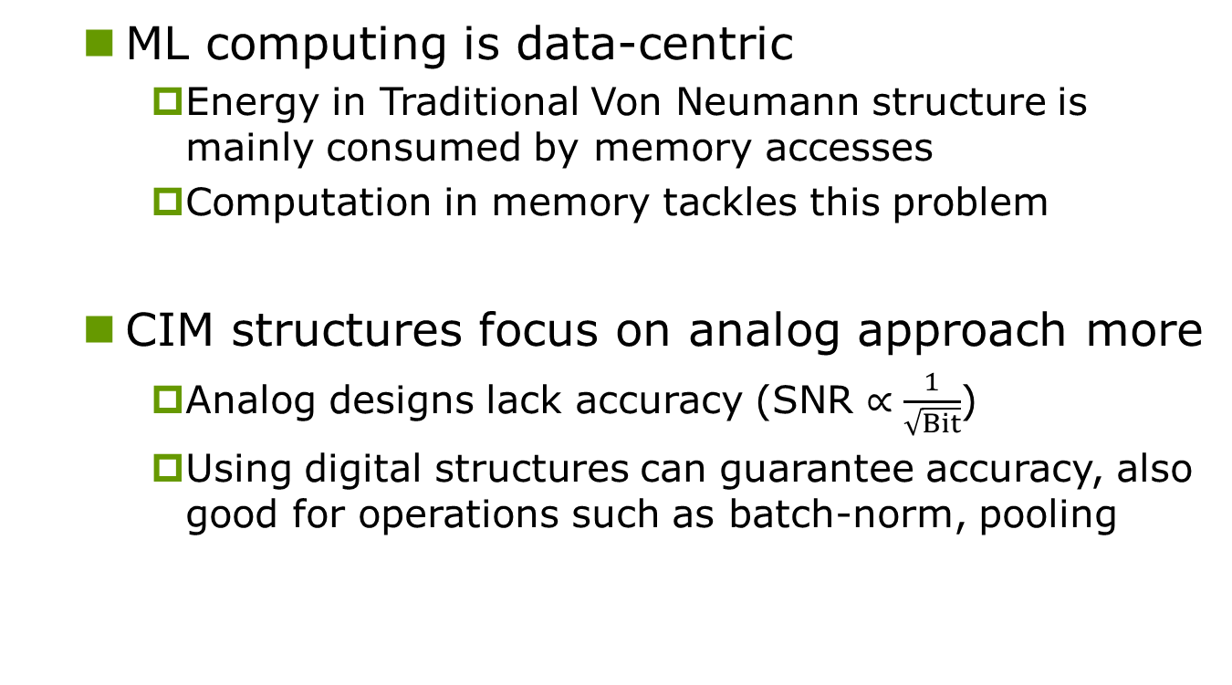
Motivation & Background
ML computing is data-centric
Energy in Traditional Von Neumann structure is mainly consumed by memory accesses
Computation in memory tackles this problem
CIM structures focus on analog approach more
Analog designs lack accuracy (SNR $∝\frac{1}{\sqrt{Bit}}$)
Using digital structures can guarantee accuracy, also good for operations such as batch-norm, pooling
INPUT
ALU
Memory
OUTPUT

Slide 3
Features
High bit-flexibility
Programmable bit-widths, signed/unsigned, and weights with 4, 8, 12, 16 bit widths..
Parallel MAC operations, with high energy/area efficiency
Allows simultaneous MAC and write operations
Time is wasted when updating weights

Slide 4
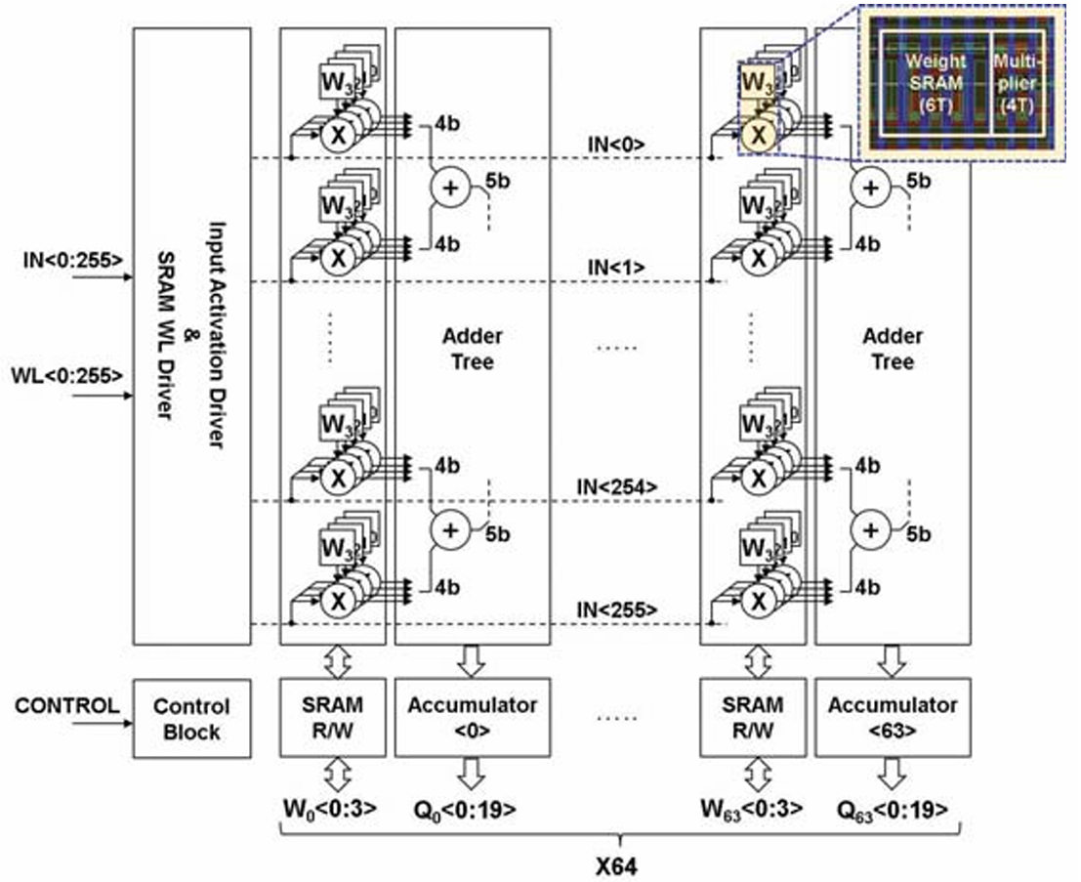
Structure
2 Mode: SRAM & CIM
SRAM: update weight
CIMW: MAC operation, support 256×64 multiplication

Slide 5
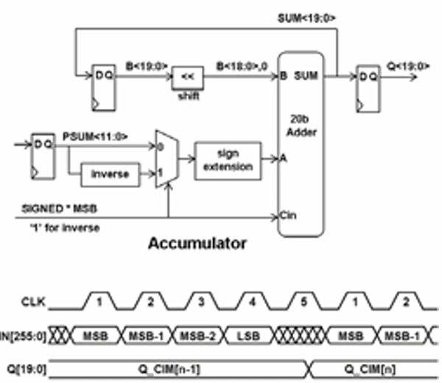
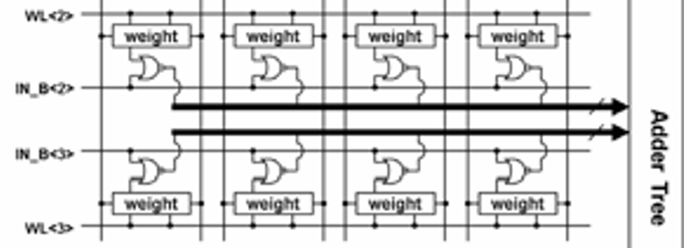
Structure
2 Mode: SRAM & CIM
SRAM: update weight
CIMW: MAC operation , support 256×64 multiplication
Require 5 cycles for
4-bit input activation

Slide 6
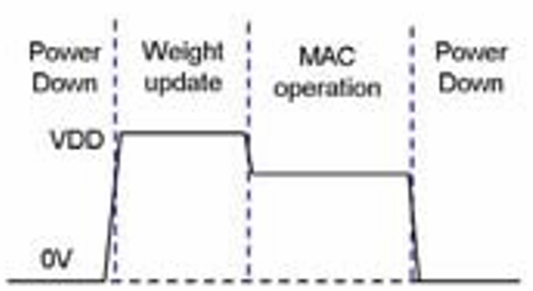
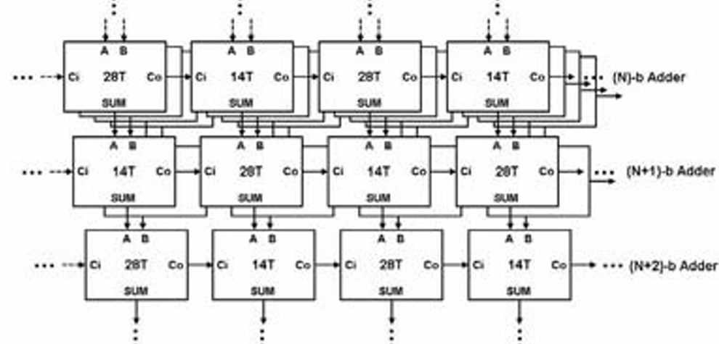
Structure
Dynamic voltage scaling
0.8V for weight updating
0.68V for MAC operation
Better NM and less dynamic power
Interleaved 28T & 14T Adder
Lower dynamic power

Slide 7
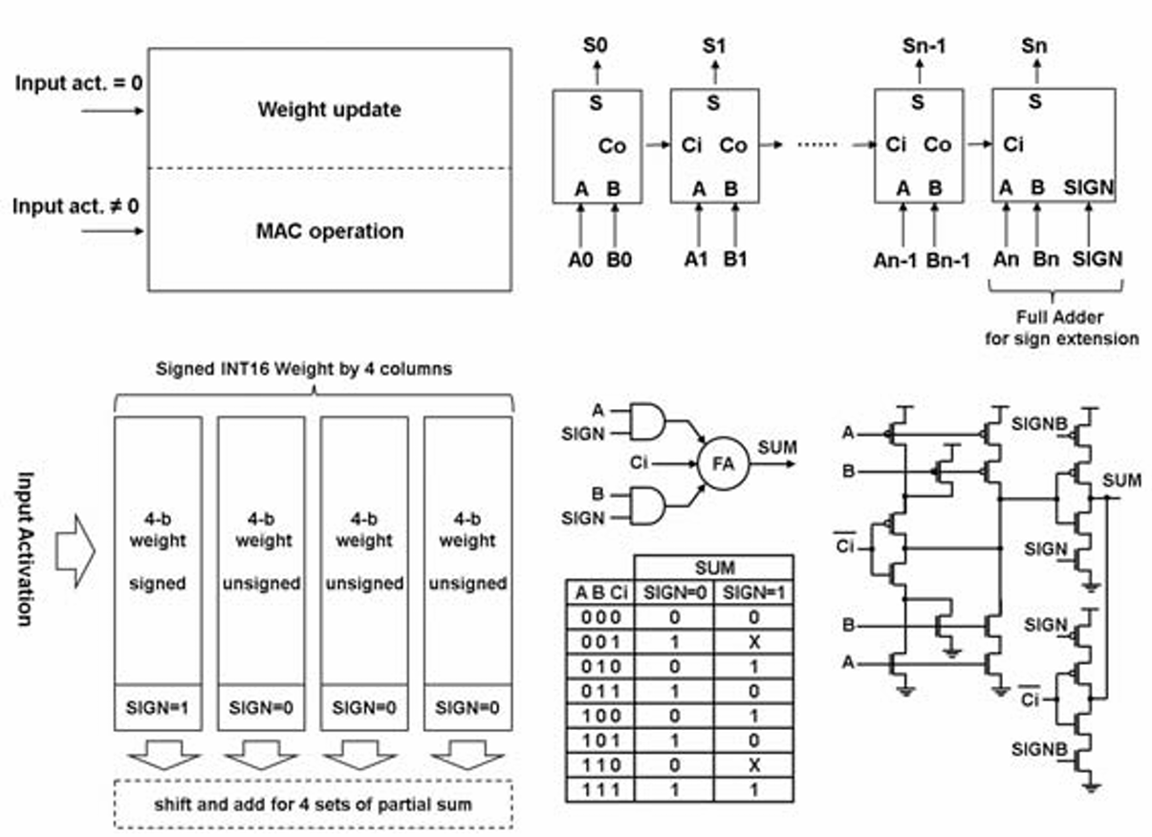
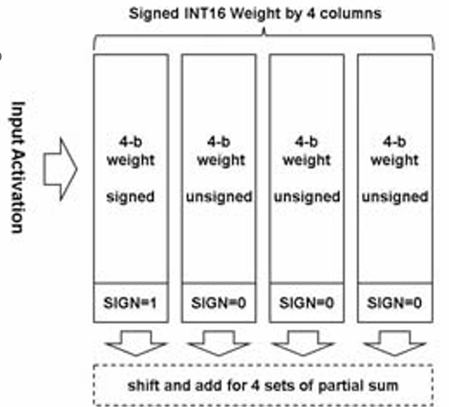
Structure
Update weight and perform MAC simultaneously
When input = 0, Update weight
Flexible bit width
Separate 16 bit into 4b signed And 3×4b unsigned

Slide 8
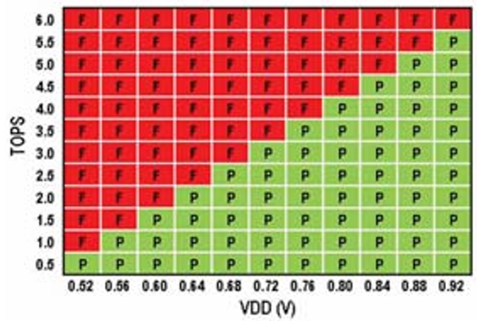
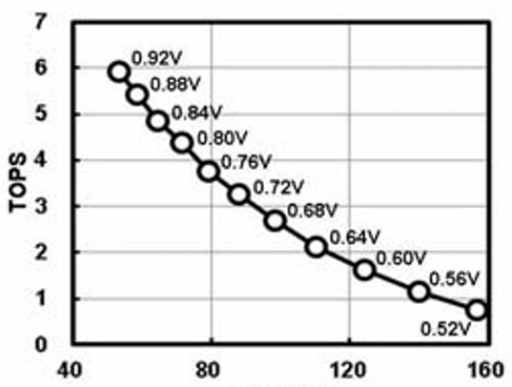
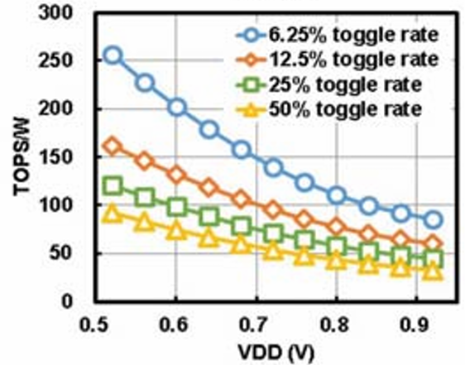
Result
89TOPS/W under 0.72V for a sparse pattern
(18% input toggle rate, 50% 1s for weights)
52TOPS/W for a dense pattern
(50% input toggle rate, 50% 1s for weights)
3.3TOPS from 0.72V at 25°C
TOPS/W and TOPS/area improving by 2.8× and 19× under 5nm process compared to 22nm design

Slide 9
Conclusion
Full precision
Digital adder tree structure with 256×64 bit sram array
Low power
Dynamic voltage scaling ( lower VDD for MAC )
Half of the 28T adders are replaced by 14T adders
Highly programmable
Support different input bit-width and weight bit-width
Requires extra adder for sign extension and control blocks

Slide 10
2022
PPT TemplateCredit : Jie-Hong Roland Jiang

Slide 11
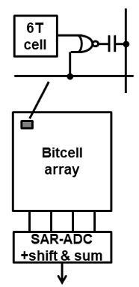
Motivation & Background
Accuracy and scale of analog approach is limited
MOS PVT variation
ADC output range under dynamic voltage scaling
Truncation and gain error of ADC
Nonlinear Id due to drain-induced-barrier-lowering for current-based approach (lower Vt for short channel)
Smaller caps with technology-scaling for cap-approach
Analog components are not good for testing

Slide 12
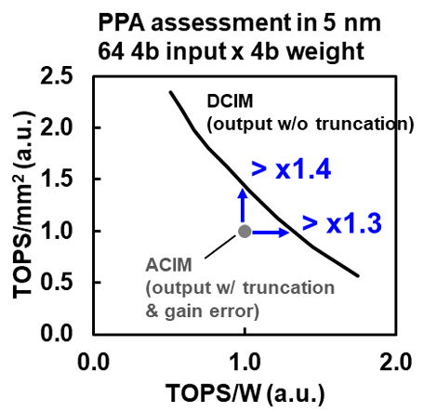
Motivation & Background
Digital approach achieves better performance
>1.3× power efficiency
>1.4× performance/area efficiency

Slide 13
Features
Allows simultaneous MAC and write operations
Time is wasted when updating weights
Small area
Low power
Flexible bit width
4b, 8b, … weight and input

Slide 14
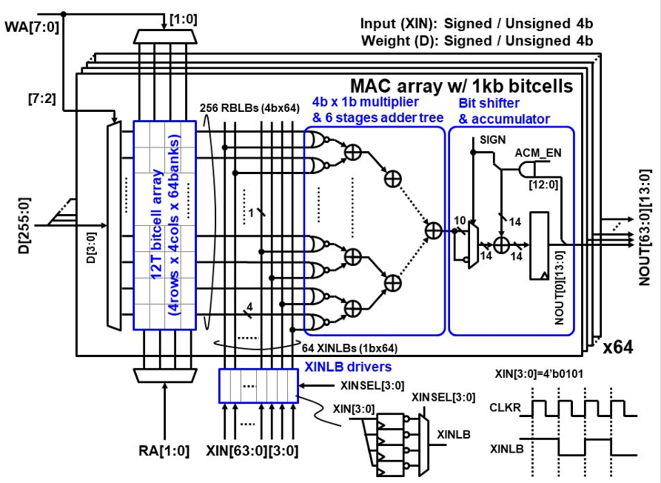
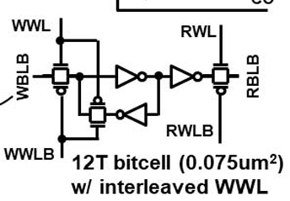
Structure
64 MAC arrays with 64kb of 12T sram cell
64 banks, each bank contains 4b×4b
MAC operation requires 5 clock cycles

Slide 15
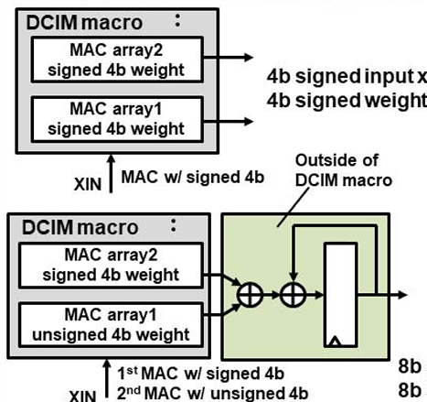
Structure
Read operations reads data from the cell to NOUT
Accumulator/Adder does sign extension if needed
Can support 8b data or more

Slide 16
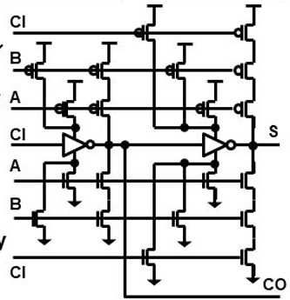
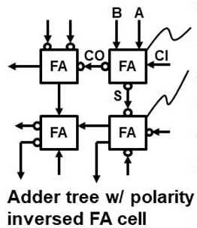


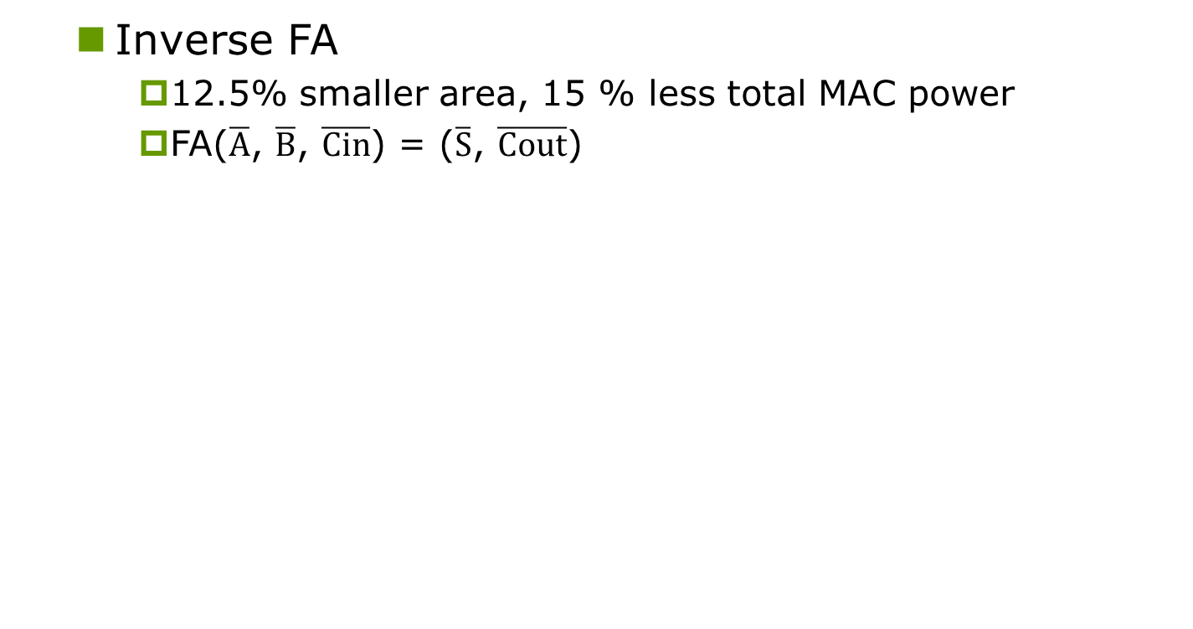



Structure
Inverse FA
12.5% smaller area, 15 % less total MAC power
FA($\overline{A}$, $\overline{B}$, $\overline{Cin}$) = ($\overline{S}$, $\overline{Cout}$)

Slide 17
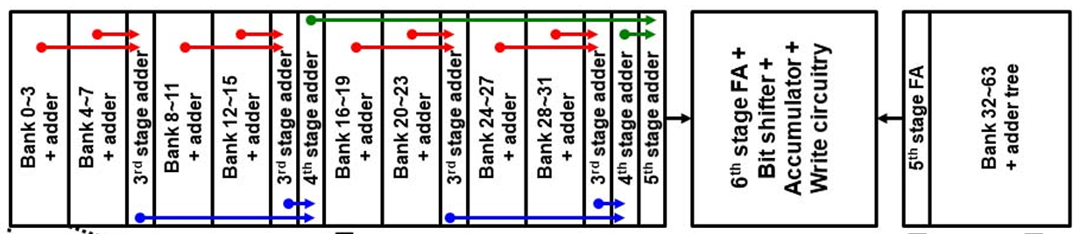
Structure
Place adder closer to sram cell
Easier for routing
Shorter wire
Merge 12T sram with logic part
No dummy space for transition region between sram/add
Space can be less than 6T sram design

Slide 18
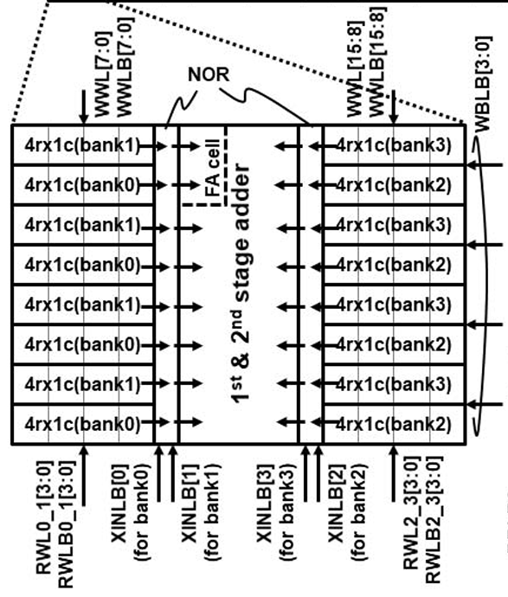
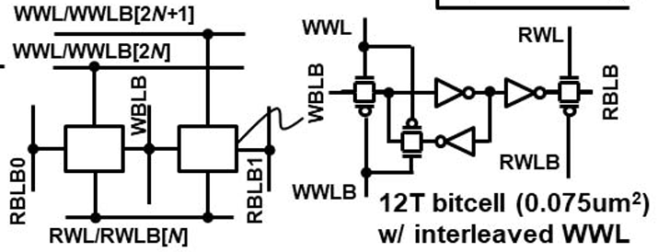
Structure
Interleaved write WL
Easier for routing in x-direction
Shared Read WL
Easier for routing in y-direction

Slide 19
Structure
No RBL precharge
CMOS output of 12 T sram does not need precharge
Saves power

Slide 20

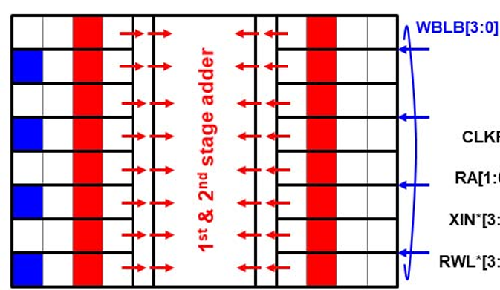
Structure
Update weight when MAC is not using the cell
Time of updating can be faster than MAC if faster clock for write operation is used

Slide 21
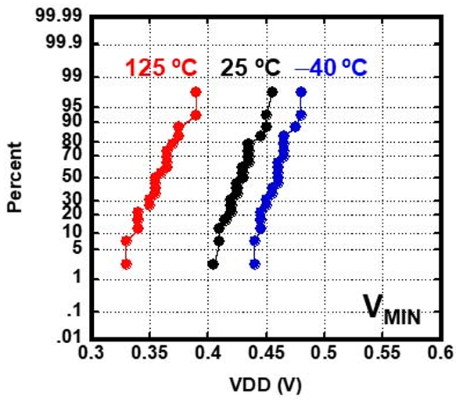
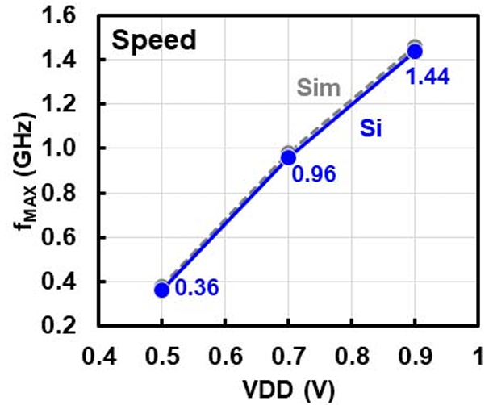
Result
Area: 12208 μm2
3× smaller than using a similar digital architecture
Vmin: 0.5V at −40°C with a 95% yield.
Fmax: 0.36, 0.96, 1.44GHz at 0.5, 0.7, 0.9V

Slide 22
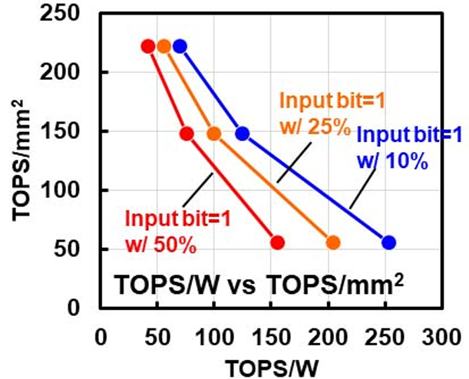
Result
TOPS/W vs TOPS/mm2 chart:
VDD = 0.5 V ~ 0.9V
253.5, 205.0 and 155.2TOPS/W with 10, 25 and 50% input bit sparsity under 0.5 V

Slide 23
Conclusion
Allows simultaneous MAC and write operations
Update weight while not used for MAC
Use a faster clock for updating
Small area
12T sram is better than 6T sram
Inversed FA
Shared WL/ interleaved WL
Low power
12T sram does not need BL precharge
Inversed FA
Flexible bit width
Additional shift and add control

